Slide 1
BOOMERANG BOOKS

Slide 2
1.PROBLEM STATEMENT
To design and develop a web application for online second hand buying and selling book system “Boomerang Books” where the customers can buy second hand books from this website and also sell their second hand books to the admin.
2.FUNCTIONALITIES
“BOOMERANG BOOKS”, an online second hand book selling system is a customized website where we can easily buy second hand books at a cheaper price.
This website also provides an option for the users where they can sell their second hand books to the admin and make profit for themselves.

Slide 3

Admin Module
Manage Products
Manage Orders
Admin
Accept request from User
View Feedbacks

Slide 4

User Module
View Books
View Book Description
Add to cart
Place Order
Make Payment
Give Feedback

Slide 5
3.TECHNOLOGIES AND TOOLS USED
Hardware Requirements
Processor : Core i3 and above
RAM : 8 GB
Hard Disk Space : 30 GB
Software Requirements
Operating System: Windows XP or above.
Front End: HTML5, CSS 3,Bootstrap and JavaScript.
Back End: Python, SQLite 3.
Editor: PyCharm.

Slide 6
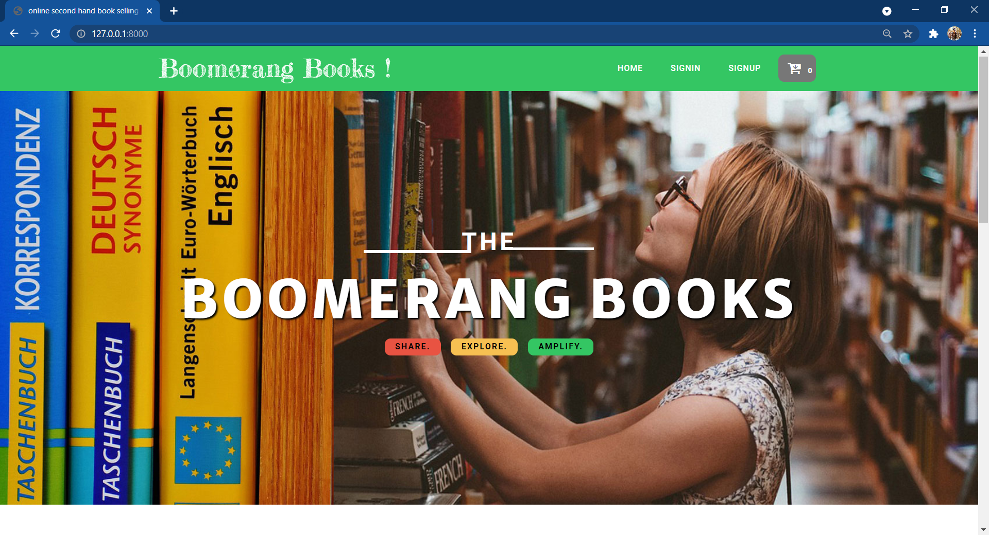
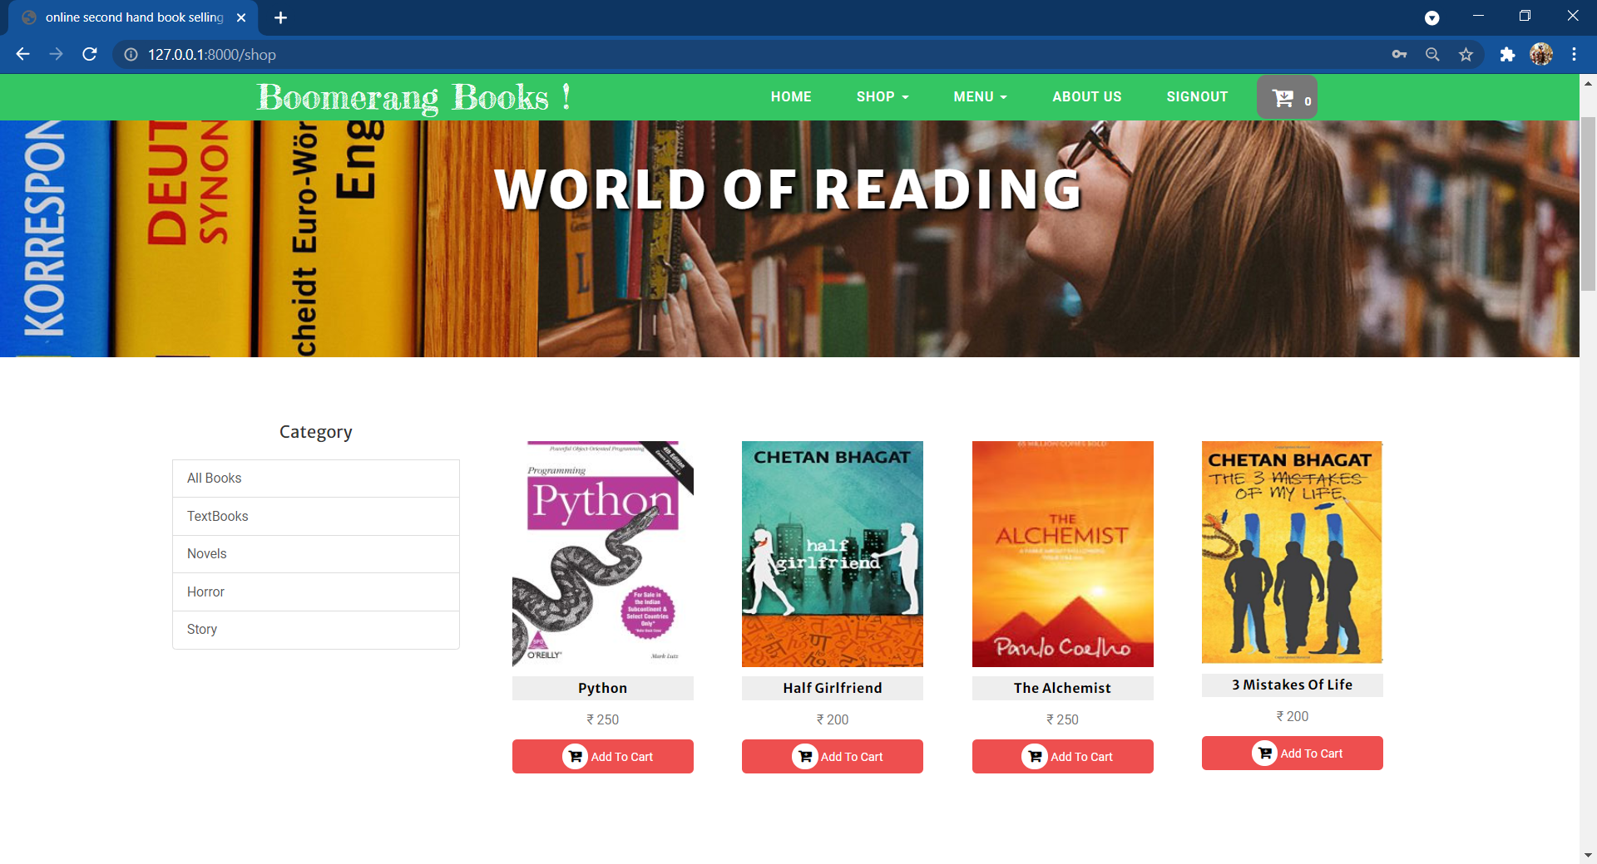
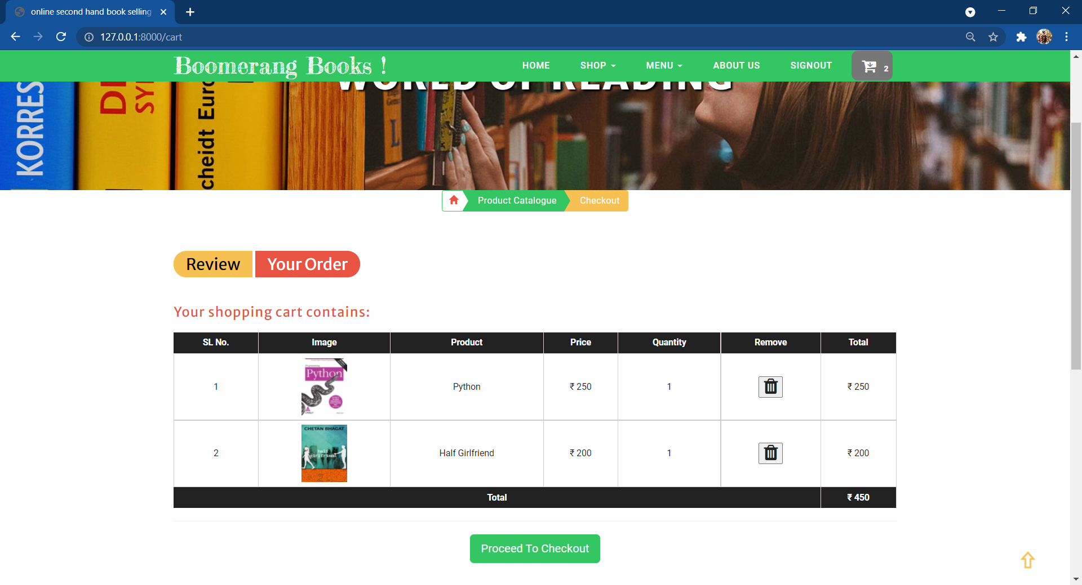
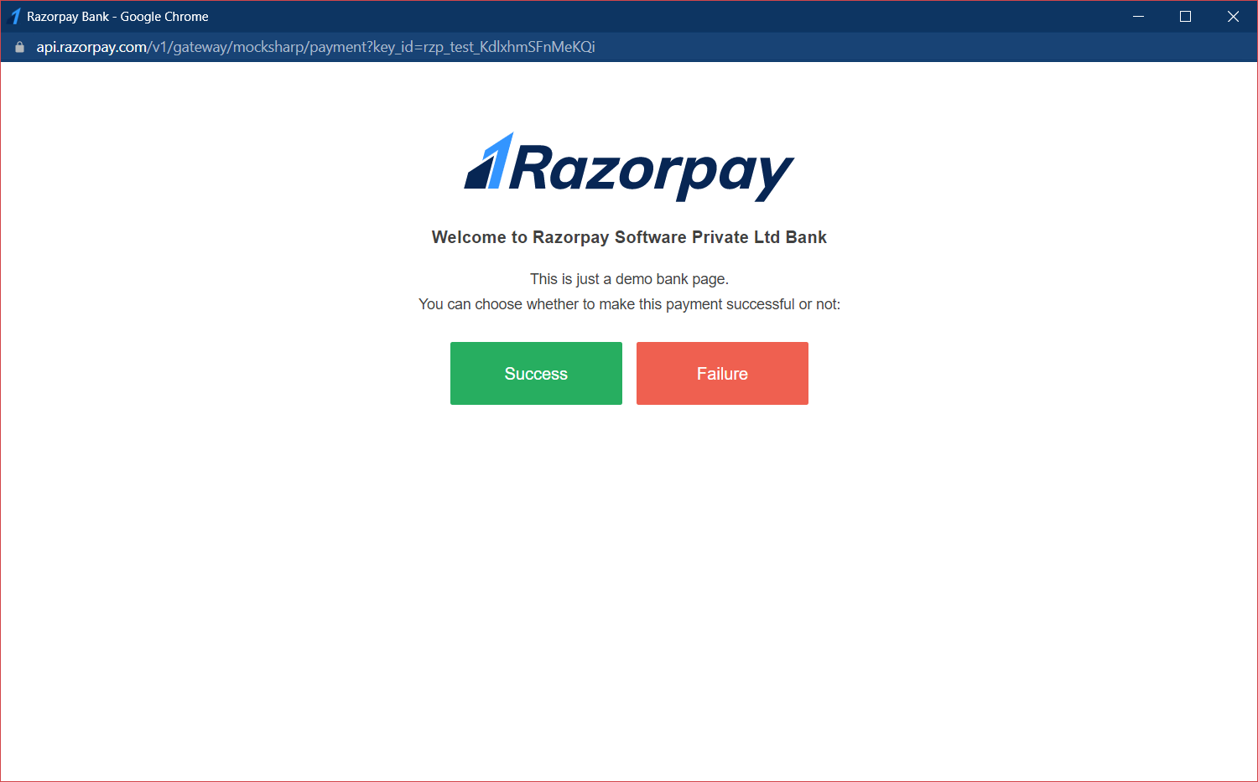
Snapshots
Fig 1.Home Page Fig 2.Product Catalog Page
Fig 3.Check-Out Page Fig 4.Payment Page

Slide 7
4. CONCLUSION
* Software is said to have attained its objective only when it meet all requirements of the user, further the user himself is the person to judge the success of the system.
* Every attempt has been made to ensure that the system is fully functional & works effectively & efficiently.
* The system has been tested with simple data to cover all possible options & checked for al outputs.
* Since the system is flexible & modular, further modifications of this package can be easily incorporated.

Slide 8
THANK YOU

